Slide 1
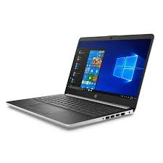

Laptop Buying Complete Guide 2020

Slide 2
Main Points:
Screen Size
Display
Processor
Hard Disk
RAM
Graphic Card

Slide 3
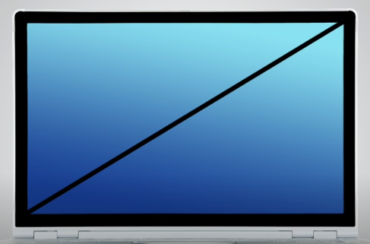
Screen Size:
Screen Size measured Diagonally always.
Normally available in three common Sizes
14 inch
15 inch
17 inch

Slide 4


Display:
HD Display: (720p) cheap
FHD Display: (1080p) expensive
UHD Display: (4K Display) 4*1024 More Expensive

Slide 5
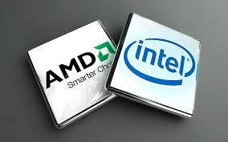
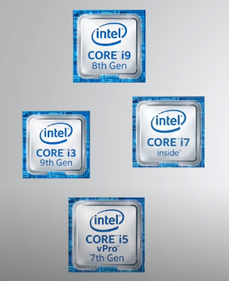
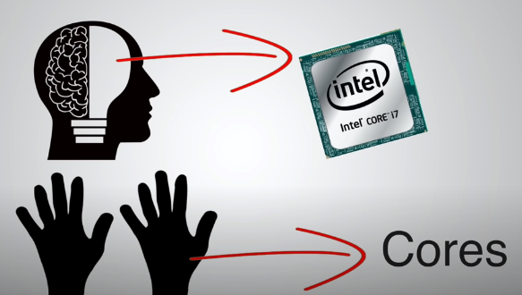
Processor (CPU):
Core i3 (Dual Core Processor) Better for Normal Task
Core i5 (Dual Core or Quad Core) Better for Heavy Task like Video Editing, Games etc.
Core i7 4 or 6 Cores (High End laptops) Better for 3D Software, heavy gaming, 4K Video Editing
Core i9 6 or 8 Cores (High End laptops)
Next Generation Less Transistor Size for More Optimized Performance (nm)
Cache Memory (L1,L2,L3,L4)
Clock Speed (Ghz)

Slide 6
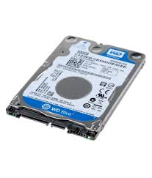
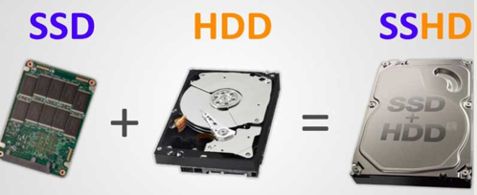
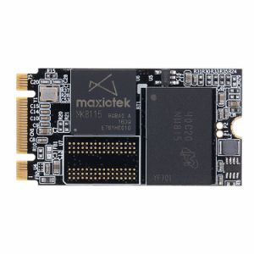
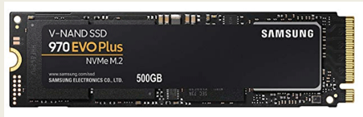
Hard Disk:
HDD
SSD
SSHD
SSD M.2

Slide 7
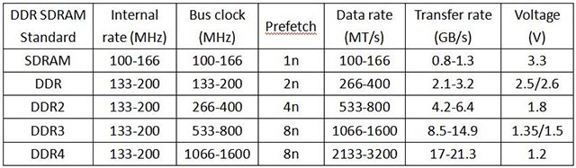
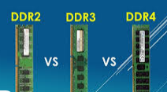
RAM:
Core i3 : Min 4GB
Core i5 : Min 8GB
Core i7 : Min 16GB
Core i9 : Min 16GB
DDR2
DDR3
DDR4
DDR5

Slide 8
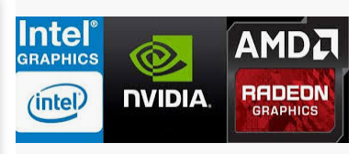


Graphic Card:
Integrated : Processor use RAM as Graphic Card
2GB Means Laptop Processor will use 2GB RAM as Graphic Card.
Load on Processor that's why Computer Slow
Dedicated: Processor will not use Ram as Graphic Card
Less load on Processor That's why fast

